Slide 1


Economics of Moving Local Healthcare
From Wall Street to Maine Street

Slide 2
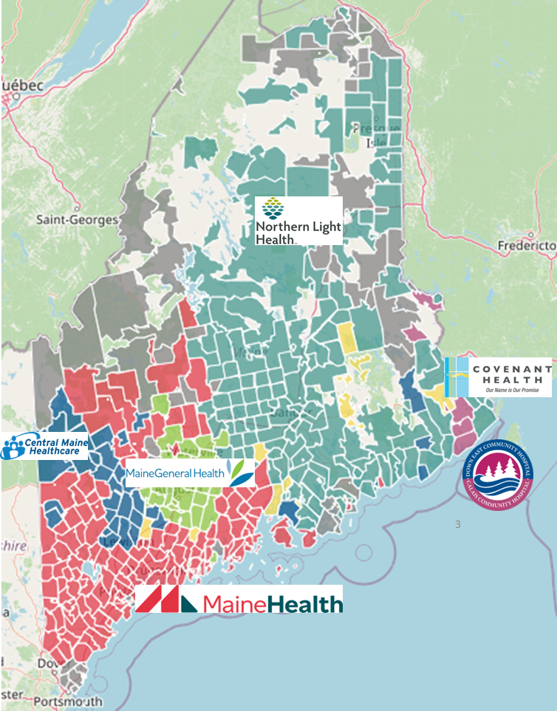
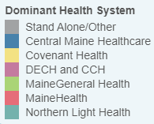
Market Share by Zip Code
Modeled from Medicare Patient Zip Code Data
Dominant Health System by Zip Code
Stand Alone/Other
Central Maine Healthcare
Covenant Health
DECH and CCH
MaineGeneral Health
MaineHealth
Northern Light Health

Slide 3
MaineHealth is at the Center of Employer Demand
Companies Headquartered by
County With 50+ Employees
Self Funded
273K
75
PLAN GROWTH POTENTIAL
548K
Insured
22
46
164
28
29
Working Age
798K
57
144
39
60
117
43
65
568
42
182
Population
1,367K
Number of Companies
100
200
300
400
500

Slide 4
MaineHealth is Patient Recommended
Health System | HCAHPS Recommendation Percentile | CMS Stars Percentile | Mortality Percentile | Readmission Percentile | KBA Brand Quality Score
MaineHealth | 63 | 84 | 77 | 80 | 67
Covenant Health (MA) | 80 | 72 | 67 | 63 | 72
Other Independent Hospitals | 70 | 64 | 62 | 68 | 69
MaineGeneral Health | 59 | 100 | 61 | 87 | 64
Northern Light Health | 49 | 78 | 70 | 80 | 61
Central Maine Healthcare | 37 | 61 | 57 | 85 | 57

Slide 5

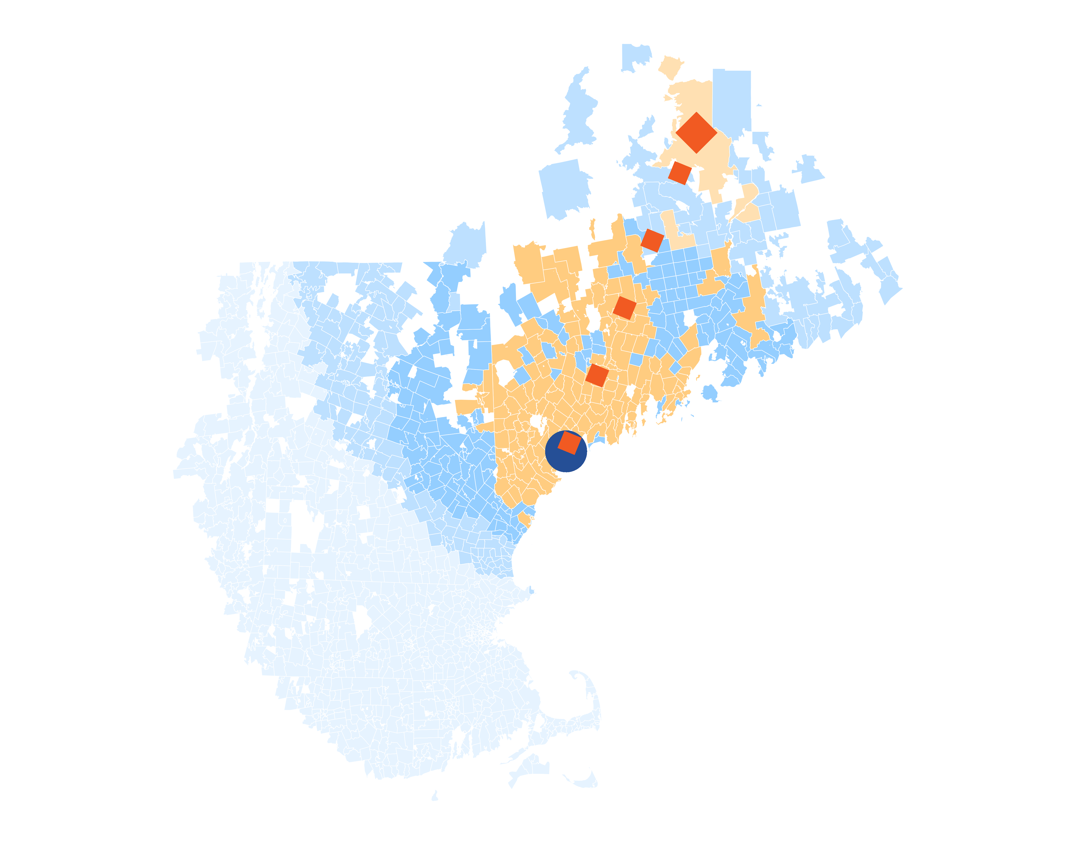
Patients are Driving
Further to Reach
MaineHealth
14 patients (admissions) traveled 272.4 miles to Maine Medical Center despite 34 closer hospitals.
A probabilistic model of patient zip codes in the Medicare HSAF data reveals that MaineHealth brand quality is attracting patients from farther away than expected.

Slide 6

State-wide Plan Size
Control
Transformation
$
Margin
$
Volume/Profit
Steerage to MaineHealth
Beneficial Pricing

Slide 7
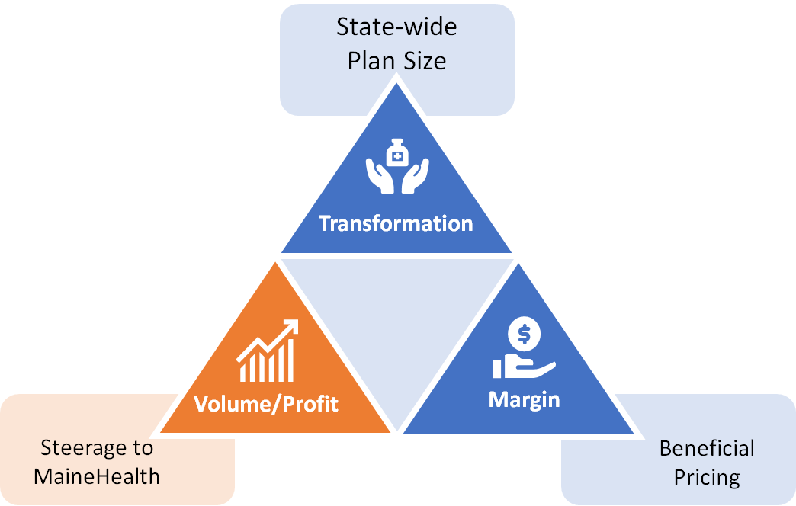

Traditional Volume-Based DTE
Year | Target Employees | Target Members
1 | 500 | 1,000
2 | 1,100 | 2,000
3 | 1,800 | 3,200
4 | 2,800 | 5,000
5 | 4,100 | 7,400
6 | 5,700 | 10,300
7 | 7,800 | 14,000
8 | 10,300 | 18,500
9 | 13,500 | 24,300
10 | 17,300 | 31,100
11 | 21,600 | 38,900
12 | 26,400 | 47,500
13 | 31,400 | 56,500
14 | 36,400 | 65,500
15 | 41,200 | 74,200
16 | 45,600 | 82,100
17 | 49,400 | 88,900
18 | 52,600 | 94,700
19 | 55,200 | 99,400
20 | 57,200 | 103,000
21 | 58,700 | 105,700
22 | 59,800 | 107,600
23 | 60,700 | 109,300
24 | 61,300 | 110,300
25 | 61,800 | 111,200
Early Stage
Gaining Name Recognition, Early Growth
New Revenue:
New Profit:
$15.31M
$1.73M
Growth Stage
Strong Reputation, Strong Growth
New Revenue:
New Profit:
$106.68M
$13.26M
Mature Stage
High Profitability, Market Saturation
New Revenue:
New Profit:
$212.54M
$26.58M

Slide 8
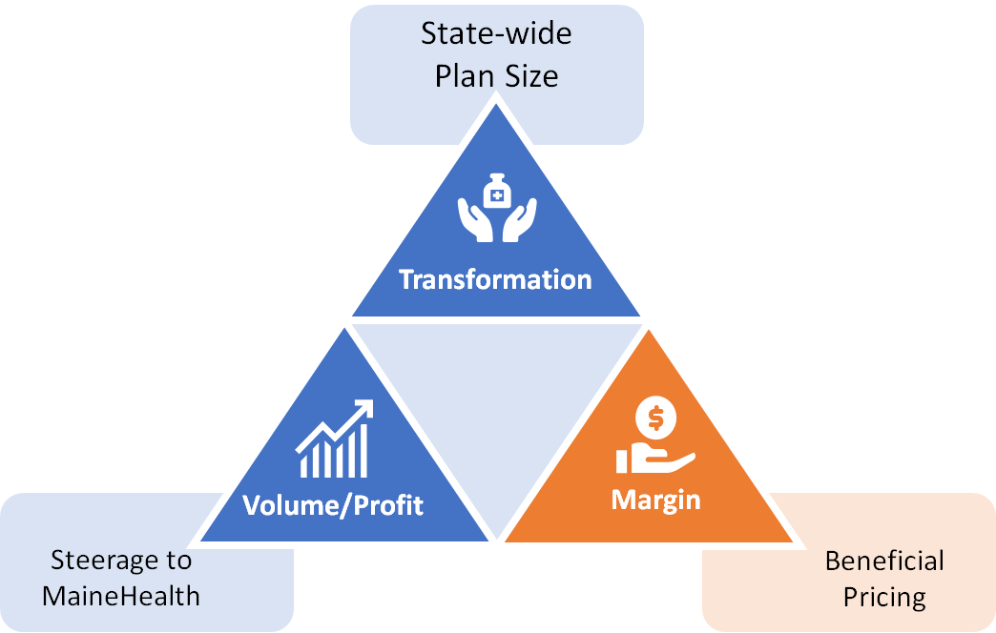
Margin-Focused DTE
Year | Target Employees | Target Members
1 | 100 | 200
2 | 200 | 400
3 | 300 | 500
4 | 400 | 700
5 | 600 | 1,100
6 | 900 | 1,600
7 | 1,200 | 2,200
8 | 1,600 | 2,900
9 | 2,100 | 3,800
10 | 2,600 | 4,700
11 | 3,300 | 5,900
12 | 4,000 | 7,200
13 | 4,800 | 8,600
14 | 5,500 | 9,900
15 | 6,300 | 11,300
16 | 6,900 | 12,400
17 | 7,500 | 13,500
18 | 8,000 | 14,400
19 | 8,400 | 15,100
20 | 8,700 | 15,700
21 | 8,900 | 16,000
22 | 9,100 | 16,400
23 | 9,200 | 16,600
24 | 9,300 | 16,700
25 | 9,400 | 16,900
Early Stage
Gaining Name Recognition, Early Growth
New Revenue:
New Profit:
$2.55M
$0.37M
Growth Stage
Strong Reputation, Strong Growth
New Revenue:
New Profit:
$17.78M
$3.75M
Mature Stage
High Profitability, Market Saturation
New Revenue:
New Profit:
$35.42M
$7.63M

Slide 9
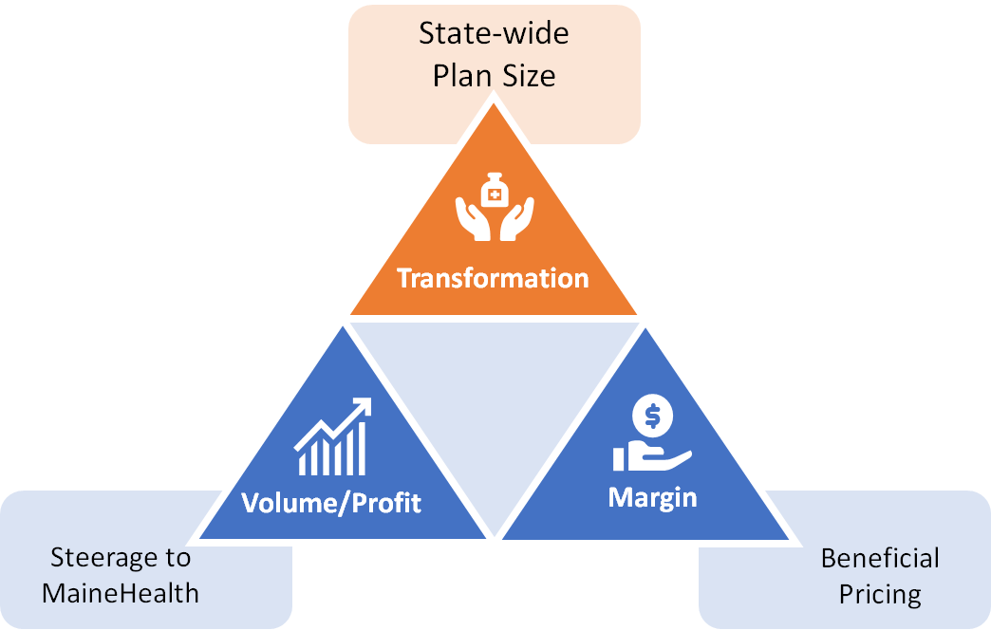
State-Wide DTE
Early Stage
Gaining Name Recognition, Early Growth
Year | Employees | Members
1 | 9,100 | 20,020
2 | 18,300 | 40,260
3 | 27,600 | 60,720
4 | 38,200 | 84,040
5 | 49,600 | 109,120
6 | 61,300 | 134,860
7 | 72,900 | 160,380
8 | 83,600 | 183,920
9 | 93,200 | 205,040
10 | 101,400 | 223,080
New Revenue:
New Profit:
$0M
$0M
Growth Stage
Strong Reputation, Strong Growth
New Revenue:
New Profit:
$0M
$0M
Mature Stage
High Profitability, Market Saturation
Target of reaching 20% of the population in 10 years.
New Revenue:
New Profit:
$0M
$0M

Slide 10
Per-Member Medical Spend in Maine
Health System/Group | Inpatient Market Share | Outpatient Market Share | Inpatient Dollars | Outpatient Dollars
MaineHealth | 53% | 21% | $ 1,130 | $ 1,214
Northern Light Health | 24% | 14% | $ 502 | $ 800
Central Maine Healthcare | 7% | 4% | $ 141 | $ 243
MaineGeneral Health | 7% | 5% | $ 151 | $ 275
Other Standalone Hospitals | 5% | 7% | $ 97 | $ 374
Covenant Health | 4% | 4% | $ 93 | $ 213
DECH and CCH | 0% | 1% | $ 8 | $ 55
Independent Ambulatory |  | 44% |  | $ 2,484
PMPY Commercial
Medical
Inpatient/Ambulatory
Spend*
$7,779
*Number is derived from KBA data warehouse, drawing from over $3B in yearly adjudicated charges to estimate PMPY spend by inpatient, outpatient and professional charges. Pharmacy and non-health-system charges are excluded.
Using the Milliman area adjustment factors by zip code, charges are standardized to local estimates.
These estimated charges are conservative as KBA claims average ~15% below the market average.

Slide 11
The Impact of Just 1% Price or Net Collections Improvement
Health System/Group | Commercial Margin | Government Margin | Commercial Per-Member Net Income | Revenue Impact of 1% Price Improvement Per 100K Members | Net Income Impact of 1% Price Improvement Per 100K Members
MaineHealth | 15% | -111% | $352 | $2,343,835 | $351,575
Northern Light Health | 27% | -127% | $351 | $1,301,673 | $351,452
Central Maine Healthcare | 23% | -175% | $88 | $384,647 | $88,469
MaineGeneral Health | 35% | -222% | $149 | $425,718 | $149,001
Other Standalone Hospitals | 36% | -117% | $170 | $470,911 | $169,528

Slide 12
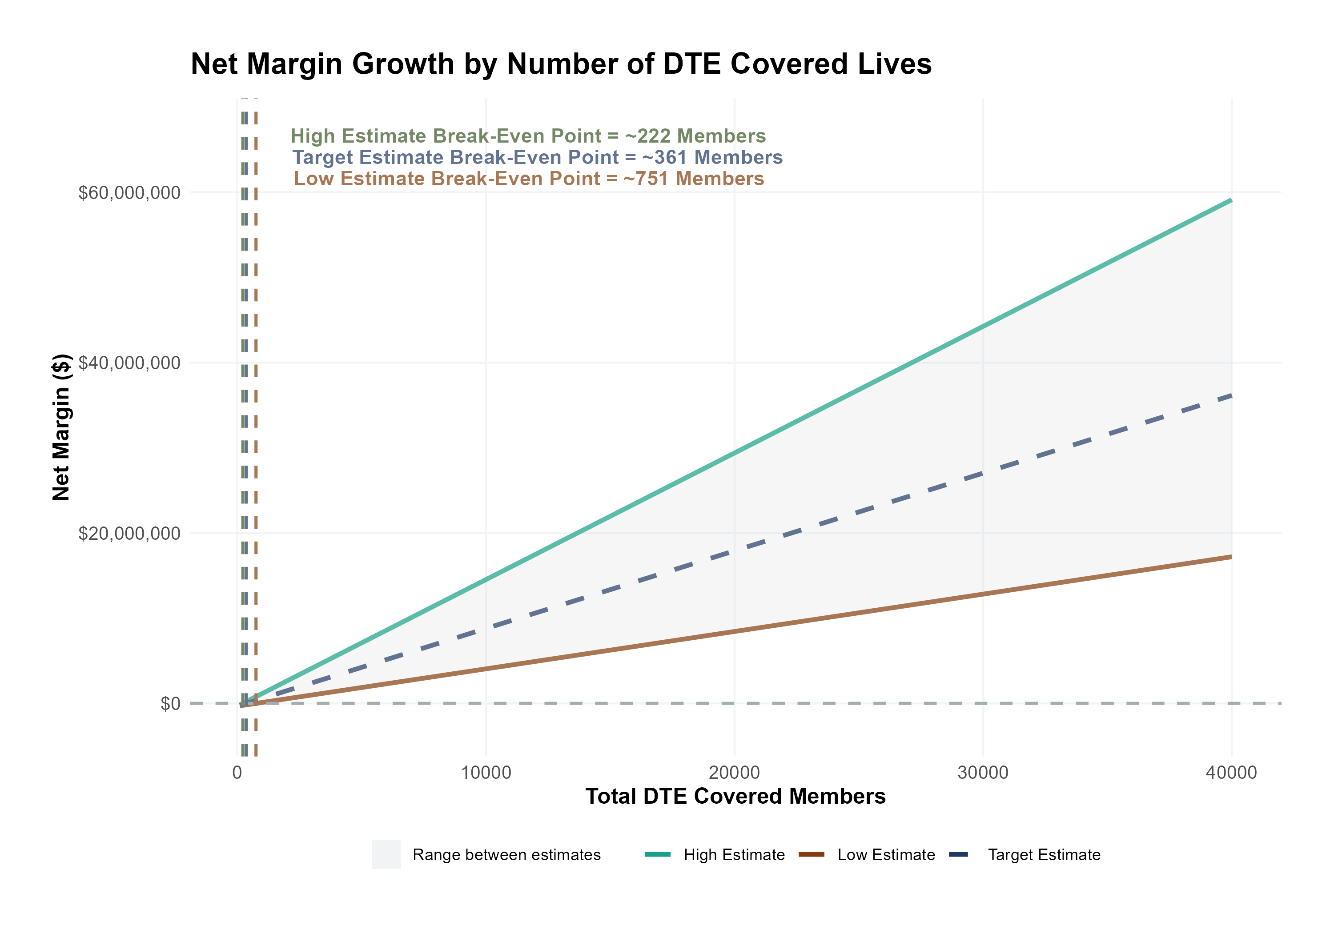
Estimated Financial Returns and Assumptions
Patient Steerage Assumptions
KBA currently estimates that MaineHealth has 50% inpatient market share, and 19% outpatient market compared to hospitals/clinics in Western and Central Maine. The DTE tiered structure will create immediate steerage, with additional steerage over time from patient bonus benefits and the patient card (see slide 33 for estimates of target steerage).
SINGLE-YEAR PROJECTION
Low
High
10% below target
10% above target
Commercial Margin Assumptions
KBA observes a MaineHealth 15% commercial margin. We model at a received margin in line with current commercial margins with prices 10 percentage-points below current commercial rates but with a 10 percentage-point increase through friendlier billing practices and improved patient collections with the patient card.
Low
Target
High
12%
17%
22%

Slide 13
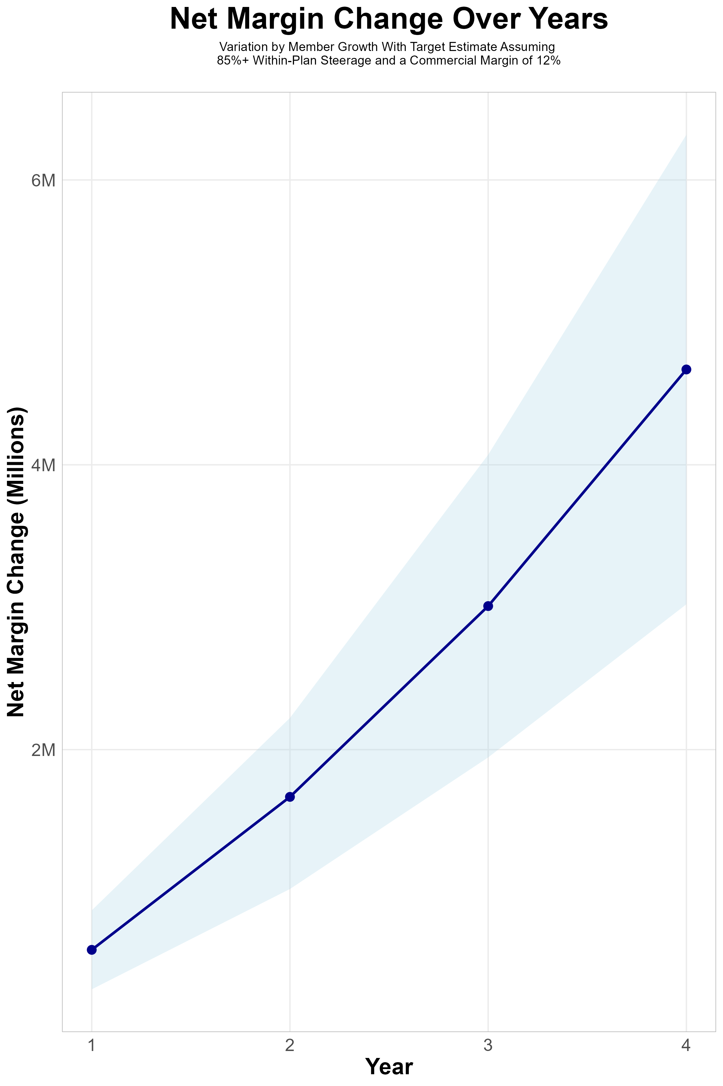
FOUR-YEAR PROJECTIONS
Target Member Growth | Target Member Growth | Target Member Growth | Target Member Growth | Target Member Growth
Metric | Year 1 | Year 2 | Year 3 | Year 4
Number of Members | 1,000 | 2,000 | 3,300 | 5,000
Incremental Margin | 912.1K | 1,824.3K | 3,148.4K | 4,789.4K
Network Access Fee | 12.0K | 24.0K | 39.6K | 60.0K
Implementation Fee (One-Time) | -150.0K | 0.0K | 0.0K | 0.0K
Sales and Marketing Costs | -180.0K | -180.0K | -180.0K | -180.0K
Net Margin Change | 594.1K | 1,668.3K | 3,008.0K | 4,669.4K
High Member Growth | High Member Growth | High Member Growth | High Member Growth | High Member Growth
Metric | Year 1 | Year 2 | Year 3 | Year 4
Number of Members | 1,300 | 2,600 | 4,400 | 6,700
Incremental Margin | 1,185.8K | 2,371.6K | 4,197.9K | 6,417.9K
Network Access Fee | 15.6K | 31.2K | 52.8K | 80.4K
Implementation Fee (One-Time) | -150.0K | 0.0K | 0.0K | 0.0K
Sales and Marketing Costs | -180.0K | -180.0K | -180.0K | -180.0K
Net Margin Change | 871.4K | 2,222.8K | 4,070.7K | 6,318.3K
Low Member Growth | Low Member Growth | Low Member Growth | Low Member Growth | Low Member Growth
Metric | Year 1 | Year 2 | Year 3 | Year 4
Number of Members | 700 | 1,300 | 2,200 | 3,300
Incremental Margin | 638.5K | 1,185.8K | 2,099.0K | 3,161.0K
Network Access Fee | 8.4K | 15.6K | 26.4K | 39.6K
Implementation Fee (One-Time) | -150.0K | 0.0K | 0.0K | 0.0K
Sales and Marketing Costs | -180.0K | -180.0K | -180.0K | -180.0K
Net Margin Change | 316.9K | 1,021.4K | 1,945.4K | 3,020.6K

Slide 14
SINGLE YEAR SUMMARY
DTE Covered Members Financial Analysis | DTE Covered Members Financial Analysis | DTE Covered Members Financial Analysis | DTE Covered Members Financial Analysis | DTE Covered Members Financial Analysis | DTE Covered Members Financial Analysis | DTE Covered Members Financial Analysis | DTE Covered Members Financial Analysis
Target Estimate Assuming 85%+ Within-Plan Steerage and a Commercial Margin of 12%. | Target Estimate Assuming 85%+ Within-Plan Steerage and a Commercial Margin of 12%. | Target Estimate Assuming 85%+ Within-Plan Steerage and a Commercial Margin of 12%. | Target Estimate Assuming 85%+ Within-Plan Steerage and a Commercial Margin of 12%. | Target Estimate Assuming 85%+ Within-Plan Steerage and a Commercial Margin of 12%. | Target Estimate Assuming 85%+ Within-Plan Steerage and a Commercial Margin of 12%. | Target Estimate Assuming 85%+ Within-Plan Steerage and a Commercial Margin of 12%. | Target Estimate Assuming 85%+ Within-Plan Steerage and a Commercial Margin of 12%.
DTE Members | Pre-DTE Revenue | Pre-DTE Margin | DTE Revenue | DTE Incr. Revenue | DTE Total Margin | DTE Incr. Margin | Net Margin Less DTE Fees
100 | $ 279K | $ 33K | $ 726K | $ 447K | $ 123K | $ 90K | $ -239K
500 | $ 1,395K | $ 167K | $ 3,632K | $ 2,237K | $ 617K | $ 450K | $ 126K
1,000 | $ 2,790K | $ 335K | $ 7,264K | $ 4,474K | $ 1,235K | $ 900K | $ 582K
2,500 | $ 6,974K | $ 837K | $ 18,160K | $11,186K | $ 3,087K | $ 2,250K | $ 1,950K
10,000 | $27,897K | $3,348K | $ 72,642K | $44,744K | $12,349K | $ 9,001K | $ 8,791K
20,000 | $55,794K | $6,695K | $145,283K | $89,489K | $24,698K | $18,003K | $17,913K

Slide 15
Year 4 Projected Revenue and Profit
Pre-DTE Cohort of 5,000 Employees | Inpatient | Outpatient | Professional | Total
Revenue† | $ 6,844,470 | $ 4,842,660 | $ 2,261,481 | $ 13,948,611
Net Income‡ | $ 821,336.4 | $ 581,119.2 | $ 271,377.7 | $ 1,673,833
† Assuming proportional revenues from market shares of 50% (inpatient) and 19% (outpatient)
‡ Conservatively assuming a commercial margin of 17% (80% of the estimated commercial margin)
With DTE | Inpatient | Outpatient | Professional | Total
Revenue⁰ | $ 10,605,598 | $ 18,446,406 | $ 8,614,315 | $ 37,666,318
Net Income* | $ 1,802,952 | $ 3,135,889 | $ 1,464,434 | $ 6,403,274
⁰ Assuming 77% inpatient and 74% market steerage based on KBA narrow network DTE experience (see previous slide)
* Conservatively assuming a commercial margin of [MM]%, with a 10 percentage-point reduction to reflect competitive-edge rates and a 10 percentage-point increase due to lower billing costs and higher patient responsibility collections because of the member credit card.
Total Increase in Net Income | $ 4,729,441
Network Access Fee (Revenue) of $1 PMPM | $ 60,000
Total Profit Growth | $ 4,734,241
Minus Implementation Fee (One-Time) | -$ 0
Minus Sales and Marketing (Annual – Ongoing) | -$ 180,000
Total | $ 4,609,441

Slide 16
The Win/Win of Cutting Out the Middle Man
Healthcare Delivery Costs Are Able to Continue to Grow
Employers See Dramatically Lower Overall Healthcare Costs

Slide 17

Traditional Value-Based Care is Backwards
Employers/payer and ACO provider organization spend millions forecasting and contracting for value-based care, negotiating about capitation, metrics, reporting periods and quality measurements.
ACO provider organizations deliver care constantly encumbered by new metrics. Team cost millions watching and optimizing on the metrics.
ACO provider organizations are solely responsible for patient engagement.
Messy assessments of metrics determine financial outcomes.
Both the ACO provider organizations and the employers/payer find very little value and discontinue this effort.

Slide 18

DTE’s Enable True Value-Based Care
Employers Choose Maine Street Health because they trust the provider organizations.
Providers in Maine Street Health have the flexibility to deliver exemplary care at a value price.
Employers and provider organizations work together to engage employee members.
Employer loyalty deepens. Employee health improves. Providers see financial gains.

